Slide 1
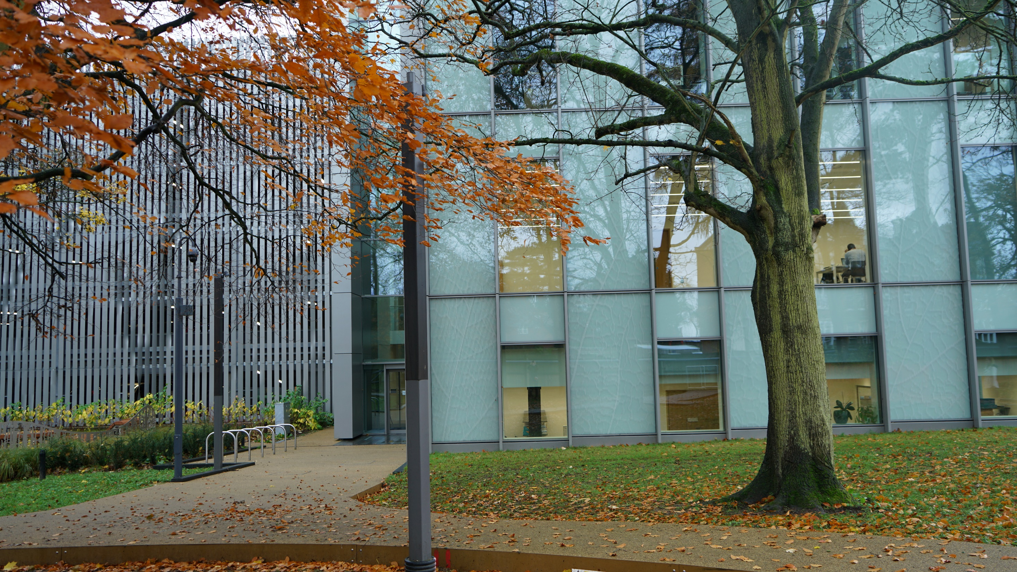

Slide 2
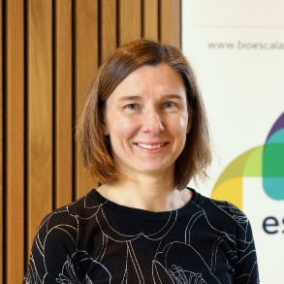
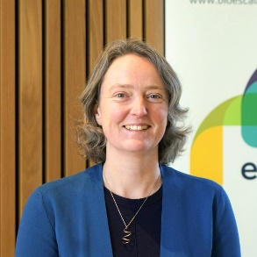
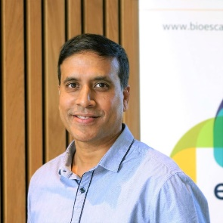
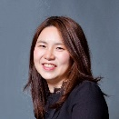
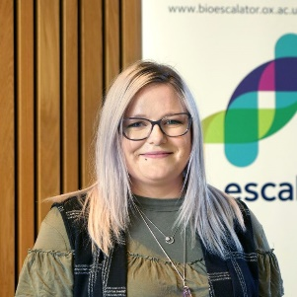
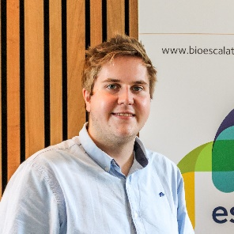
Meet the Team
Dr Claire Shingler
Business Manager
claire.shingler@medsci.ox.ac.uk
Dr Elen Wade-Martins
Innovation Project Manager
elen.wade-martins@medsci.ox.ac.uk
Dr Khwaja Islam
Lab & Facilities Manager
khwaja.islam@medsci.ox.ac.uk
Ying Hung
Senior Receptionist/Business Administrator
bioescalator.reception@medsci.ox.ac.uk
Rachel Barrett,
Events and Communications
Officer
rachel.barrett@medsci.ox.ac.uk
Fabiha Ahmed
Apprentice Lab Technician
fabiha.ahmed@medsci.ox.ac.uk
Connor Norton
IT Support
it@bioescalator.co.uk

Slide 3
Security
The front and rear Innovation Building main doors are unlocked between 08:00 – 18:00. Outside of these times, you will need to use your University card to enter the building.
Please sign in/out of the “Out of hours” book at BioEscalator Reception when entering the building before 05:30 and after 21:00.
All internal doors, except meeting rooms, require a University card to enter.
Tenant lab and office security is the responsibility of the tenants.
All visitors/contractors must sign in and out at BioEscalator Reception.
Your university card must be visible when walking around the campus.

Slide 4
University Access Cards
If you DO NOT already have a current University card |  | If you DO already have a current University card
You should have completed and returned a University card application form. This should have been emailed to you by your Line Manager. If you have not completed one of these, please email BioEscalator Reception after your induction. Once a completed application form has been submitted, it will usually take 3 – 5 working days for your new card to arrive. |  | Access to your labs, office etc. should have been added to that card on your first day. If access has not been added, please contact BioEscalator Reception after your induction bioescalator.reception@medsci.ox.ac.uk.

Slide 5
University Access Cards
Lost |  | Temporary Card
Any lost University cards must be reported to Reception. There is a £15 charge (University wide) to replace any lost cards. |  | If you forget your card, your card is damaged, or you are waiting for your replacement card, BioEscalator Reception can issue you with a temporary one.
Full Details
For full details of what to do if your card is lost, stolen, or damaged, please visit the BioEscalator intranet and look at the page titled:
‘University Cards - Lost, stolen, damaged or soon to expire’

Slide 6
Lockers
Lockers are available for tenants to use.
The allocation is:
3 per small lab
6 per large lab
1 per I-lab bench
If you are a new starter, please speak to your Line Manager if you would like a locker.
Reception have spare keys to lend out if you forget or lose your locker key.
There is a £5 charge if the key is lost.

Slide 7
Parking at the BioEscalator
Tenants
Companies are allocated 1 permit per lab occupied but its chargeable. Please discuss your requirement for a parking permit with the BioEscalator Business Manager (Claire Shingler) who will be able to advise on availability. If you require instructions on how to apply for a parking permit, please email BioEscalator Reception: bioescalator.reception@medsci.ox.ac.uk.

Slide 8
Parking at the BioEscalator
Visitors, engineers etc.
There are 5 parking spaces that belong to the BioEscalator that can be used for your visitors and service engineers. Our parking spaces are located in the multi-storey car park attached to our Innovation Building. They are down the ramp and to the right upon entry to the car park. They are marked “BIO” These parking spaces must be booked via BioEscalator Reception bioescalator.reception@medsci.ox.ac.uk A parking permit will be emailed to the requestor. The parking permit must be displayed in the windscreen of the vehicle.

Slide 9
Cycling to BioEscalator
Cycle network and bike maintenance services
BioEscalator is within 15 minutes walk of the centre of Headington Oxford’s cycle network is extensive. Please see: https://www.connectingoxford.co.uk/wp-content/uploads/2021/01/OxfordCycleandWalkingNetworkMap.jpg There is a secured bike shed at the back of the Innovation Building Bike maintenance services at Old Road Campus, (between the Big Data Institute and Kennedy Institute buildings), Fridays 9am – 5pm. This service operates via a booking sheet available midday - 4pm on Thursdays at the Richard Doll Building reception. Payment is by cash only. For more details, please visit: https://travel.admin.ox.ac.uk/bike/security#collapse1003946

Slide 10
Public Transport
Park & Ride
We encourage the use of sustainable travel and public transport options The 700 service operated by Stagecoach, runs Monday to Friday and there is a stop next to Innovation Building. 700 Thornhill Park & Ride and Oxford Parkway: stop at Old Road Campus
Bus line to Old Road Campus
15 | City Centre to Wood Farm
ST2 | Science Transit Shuttle: JR Hospital, Old Road Campus, University Science Area, Oxford Rail Station, Seacourt Park&Ride and Wytham

Slide 11
Contractors working in the BioEscalator
The person who has arranged for a contractor to work in the BioEscalator premises, must act as a Coordinator. The Coordinator is not expected to watch contractors all the time they are on site, but they must check to see that the contractor is carrying out the work as agreed.
The Coordinator must ensure that an appropriate risk assessment method statement (RAMS) has been received, prior to the work commencing from the contractor. This should be part of the contractor induction and they should be made aware of any relevant health and safety requirements or policies.
Tenants must be available to give contractors access to their laboratory or with their permission, the receptionist can issue a visitor card for the duration of visit.

Slide 12
Outgoing Mail Service
Outgoing mail is collected at 9:30am every day.
Outgoing mail must be given to Reception by 4:30pm the day before it needs to be sent out.
Your company name and the delivery service should be written on the top right-hand side, on the back, of the item you are sending.
No scientific shipments should be made through Royal Mail.
Please ask BioEscalator Reception for advice on shipping scientific items.

Slide 13
Incoming Mail Service
The Distribution Centre team will deliver parcels to labs/offices at 11:00am and 3:00pm every day.
Cold deliveries will be placed on the bench or in the lab. If you anticipate being unavailable to receive cold deliveries, please inform Lab Manager Khwaja Islam and Lab Technician Fabiha Ahmed in advance. Lab management team will ensure that the parcels are stored in the cold room or freezer as necessary.
Any letters will go into the tenant pigeonholes, which are located in the reception area.
Delivery of large or white goods is the responsibility of the tenant, not the BioEscalator, and should be delivered to the point of use.
There is a document explaining in full, the policy for the delivery of large or white goods. The policy is available on the BioEscalator intranet.

Slide 14
IT at the BioEscalator
Wi-Fi access is provided to all tenants.
Guest Wi-Fi is available for visitors. Details of which can be obtained from BioEscalator Reception. Guests must sign the Guest Wi-Fi log book.
We have a range of AV equipment in the meeting rooms. We also have the OWL,
a 360 degree webcam and microphone, perfect for hybrid meetings.
Tenants also have access to the shared printer in the hub. Details of how to set up the printer on your computer can be found on the BioEscalator intranet.
For all IT queries, contact IT@bioescalator.co.uk

Slide 15
Calpendo
Calpendo is the system used by the BioEscalator to book shared resources.
The following resources must be booked via Calpendo:
Meeting rooms
The Hub
Hot desks
Meeting pods
Core laboratory facilities
Tenants must register on Calpendo before they can start to book the above.
Instructions available on the BioEscalator intranet (Bioescalator Calpendo). If you have any queries, please contact Reception bioescalator.reception@medsci.ox.ac.uk

Slide 16
Shared Core Lab Facilities
Includes:
Tissue culture laboratory
Walk-in Cold room
-80˚C freezers/Cryogenic storage
Chemistry laboratory
Services laboratory
If your company has opted-in to using the Core Lab Facilities:
Training on equipment will be given by our lab technician.
Once you have received your training, access will be added to your University card.

Slide 17
Access to University
Research Facilities
Our tenants can access Oxford University research facilities in other buildings/departments,
e.g. Flow Cytometry, Mass Spec, NMR spectroscopy, Light Microscopy, HPLC.
For more information on this, please contact Khwaja Islam, Lab & Facilities Manager.

Slide 18
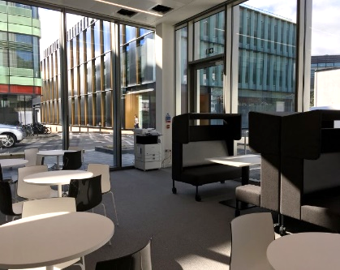
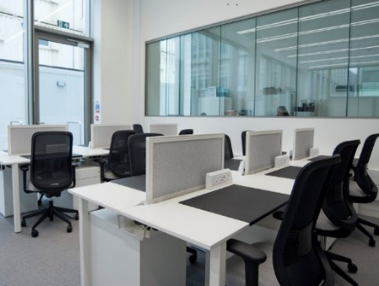
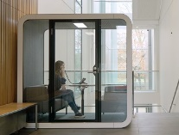
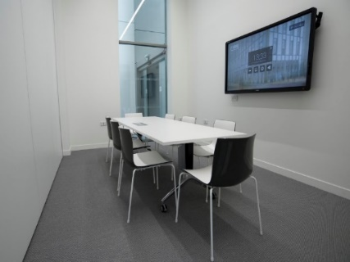
Shared Meeting Spaces
Includes:
Meeting rooms
The Hub
Hot desks
Meeting pods (ground and 1st floor)
The booths in the Hub area and in the corridor on the 1st floor are not bookable,
and are for ad hoc use only.

Slide 19
Kitchen Areas
Nespresso coffee machine and pods
Aqua tap (hot and cold water)
Microwaves (ground floor only)
Dishwasher (ground floor only)
Fridge (right-hand fridge in the Hub, small fridge on first floor)
Instant coffee, a variety of teas, hot chocolate
Sugar and cow’s milk
Please do not use the milk provided by the BioEscalator for any meals, as it is for drinks only. Instead, we ask you to bring in and label your own milk.
Please make sure to keep the kitchen areas clean and tidy. Remember to wash up/load the dishwasher after yourself and your visitors. This is a communal area so we should all work together to keep it clean and tidy.

Slide 20
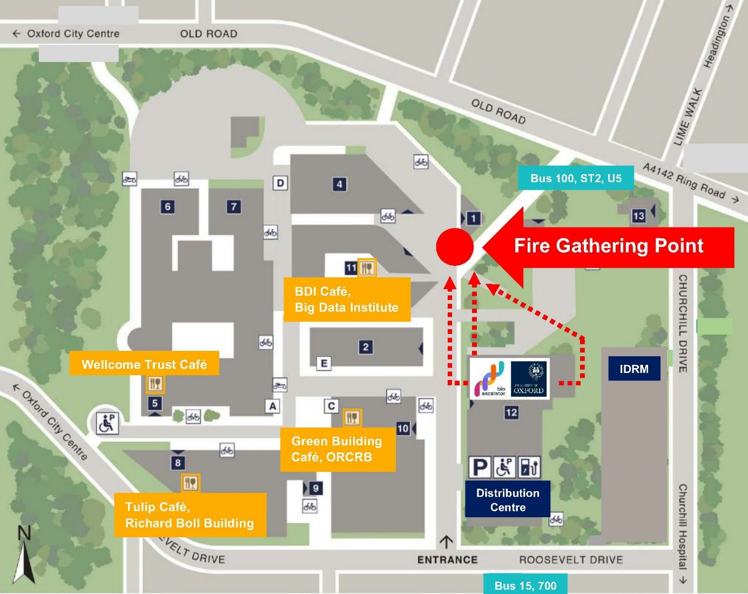
Cafés at Old Road Campus
BDI Café:
10am to 2pm, Monday to Friday
Green Building Café:
8.30am to 3pm, Monday to Friday
Tulip Café:
8.30am to 3pm, Monday to Friday
Wellcome Trust Café:
8.30am - 3pm, Monday to Friday
Churchill Hospital

Slide 21
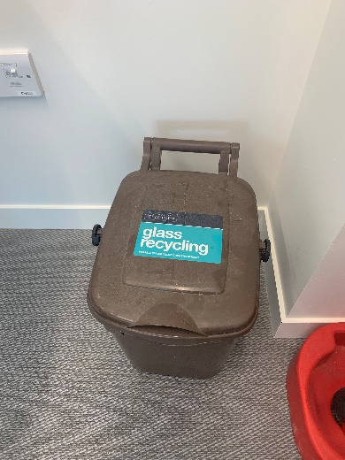
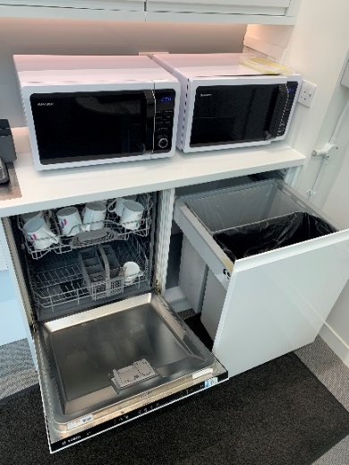
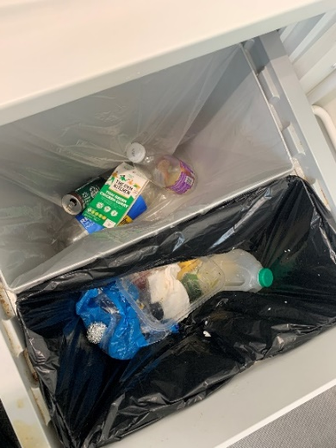
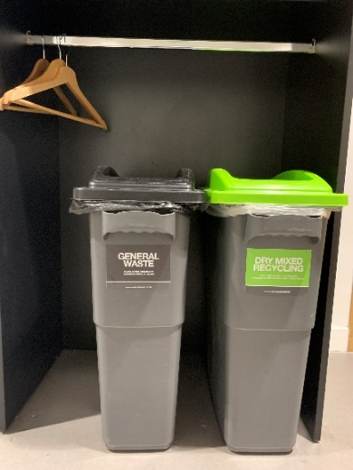
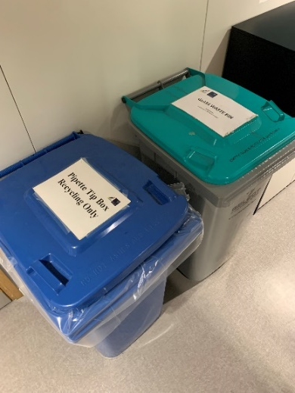
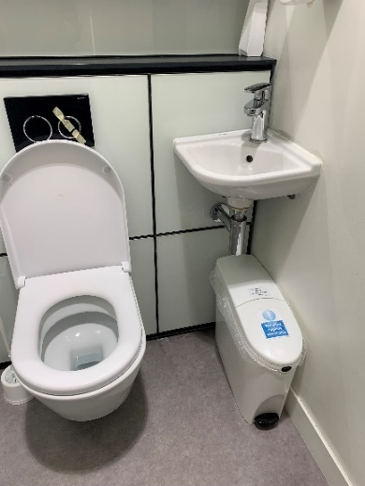
Waste and recycling
Ground floor kitchen
Dishwasher
G/F and 1/F kitchen
Kitchen general waste,
Dry mixed recycling,
Glass recycling
Corridors
General waste,
Dry mixed recycling,
Pipette tip box,
Glass waste bin
Washroom
Feminine hygiene waste only

Slide 22
BioEscalator Community
BioEscalator Operations Meeting |  | BioEscalator WhatsApp and Signal Groups
We hold a bi-monthly BioEscalator Operations Meeting, giving tenants the opportunity to voice any queries or concerns to the BioEscalator team. One or two representatives from each company must attend these meetings. They will receive a copy of the minutes taken at the meeting, which they should distribute to their team. |  | The BioEscalator has a WhatsApp group for the lab users to communicate. If you would like to be added to this, please contact Claire Shingler (Claire.Shingler@medsci.ox.ac.uk), Business Manager. There are Signal groups for Wellbeing (open to all) and CxO forum (by invitation)
Seminars, workshops and events |  | BioEscalator Socials
BioEscalator organises and sponsors seminars, workshops and events, please visit our website and follow our LinkedIn and Twitter for updates. |  | On the last Thursday of every month, we hold a social for our tenants.

Slide 23
Further Information
https://www.bioescalator.ox.ac.uk/bioescalator-intranet/homepage
The intranet is hidden on our website and password protected, so only those with the link can access it.
Contact bioescalator.reception@medsci.ox.ac.uk for current login details.
Please do not share the link, username or password with anyone outside the BioEscalator
Address & directions
Post boxes
BioEscalator tenant pricing structure
Calpendo user guide
Health and Safety
Printers
Wireless and network
Copy of the induction PowerPoint
Policies and procedures
The minutes from the last BioEscalator Operations Meeting

Slide 24
Any Questions?

