Slide 1
BioEscalator H&S induction

Slide 2
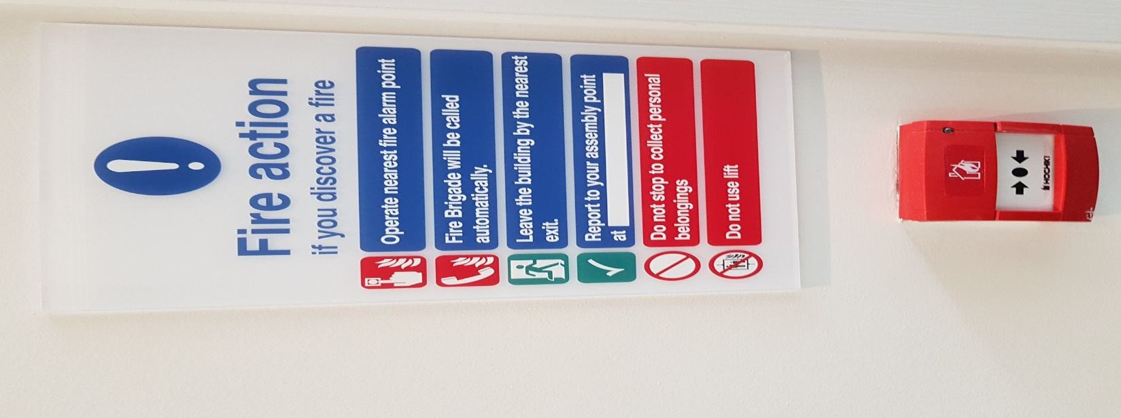
Fire action
If you discover a fire:
Operate nearest fire alarm point
Fire Brigade will be called automatically
Leave the building by the nearest fire exit
Report to the assembly point on the footpath adjacent to Triangle Nursery
Upon hearing fire alarm:
Stop what you are doing and leave the building immediately by the nearest fire exit
Report to the assembly point on the footpath adjacent to Triangle Nursery
Do not stop to collect personal belongings
Do not use lift
Do not re-enter the building until authorised to do so
Weekly Fire test every Tuesday at 11am

Slide 3
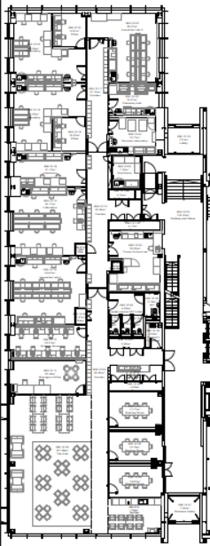
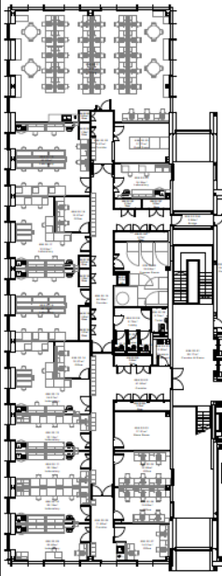
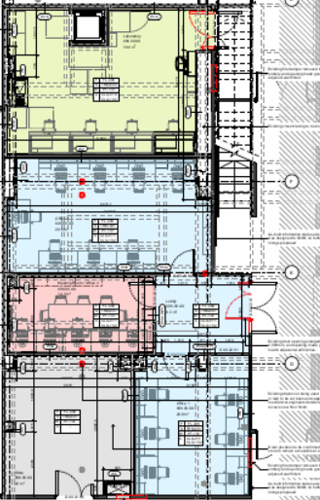
Fire Exit Locations
B
G
1

Slide 4
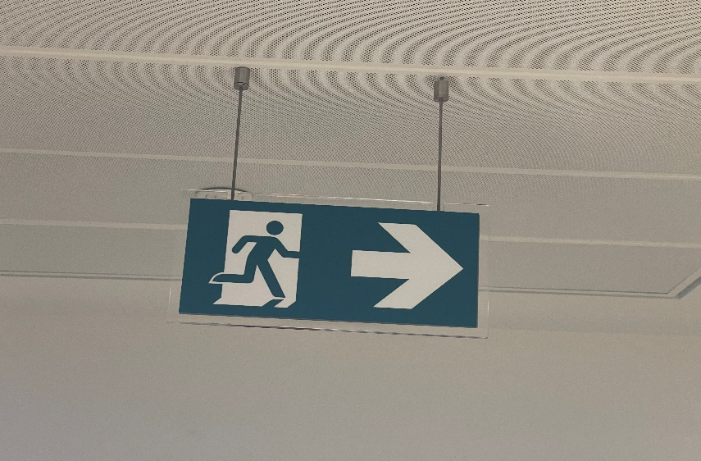
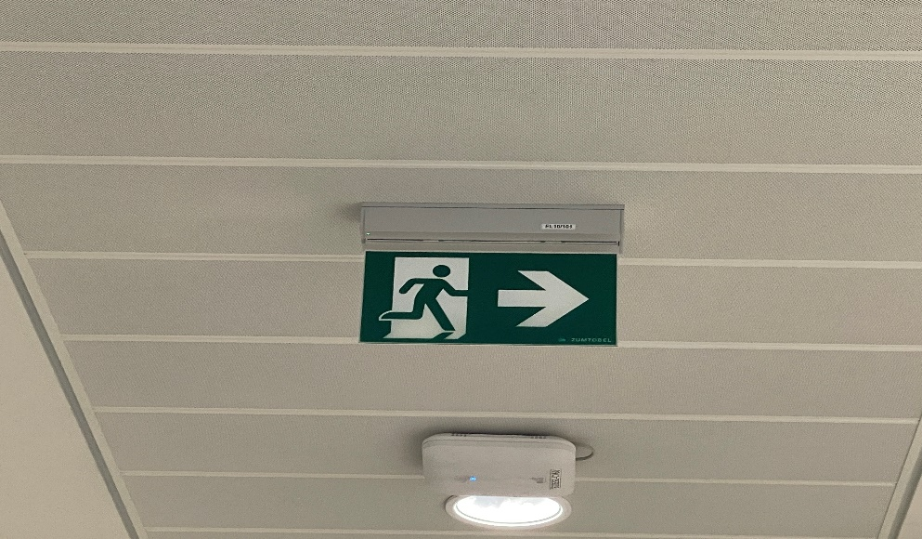
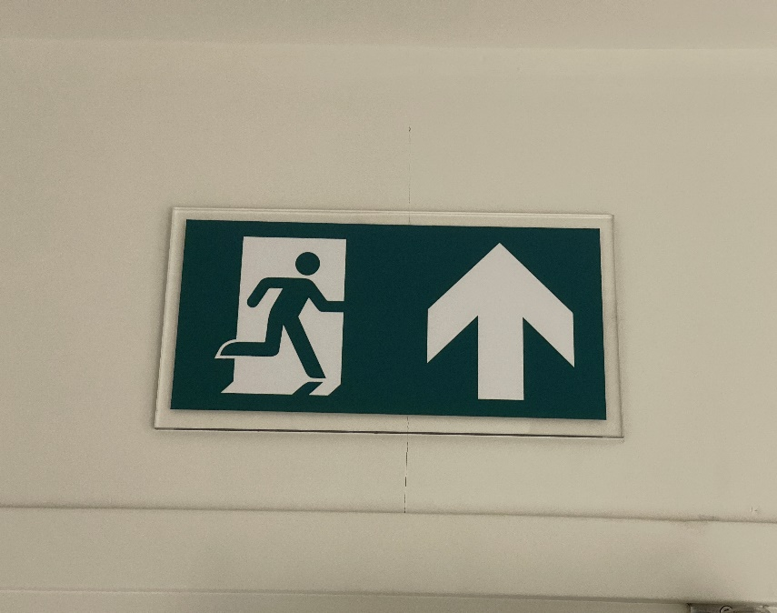
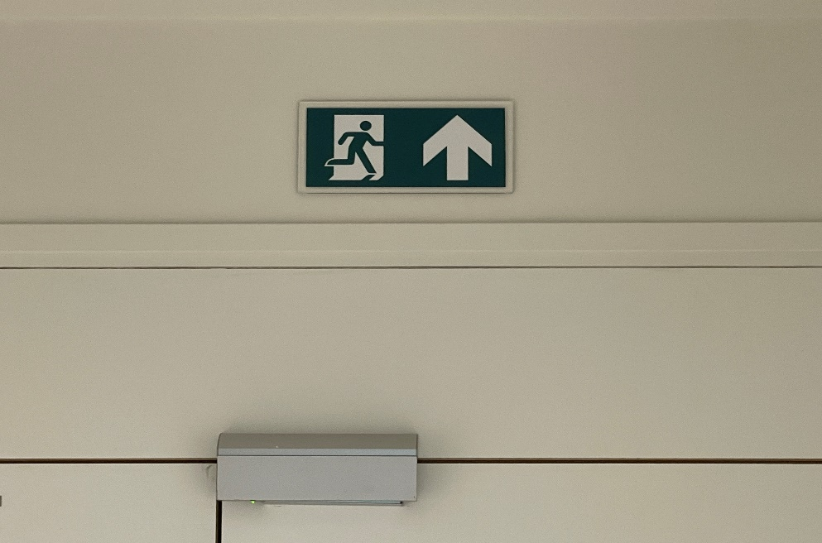
Fire Exits
Follow the green running man to exit

Slide 5
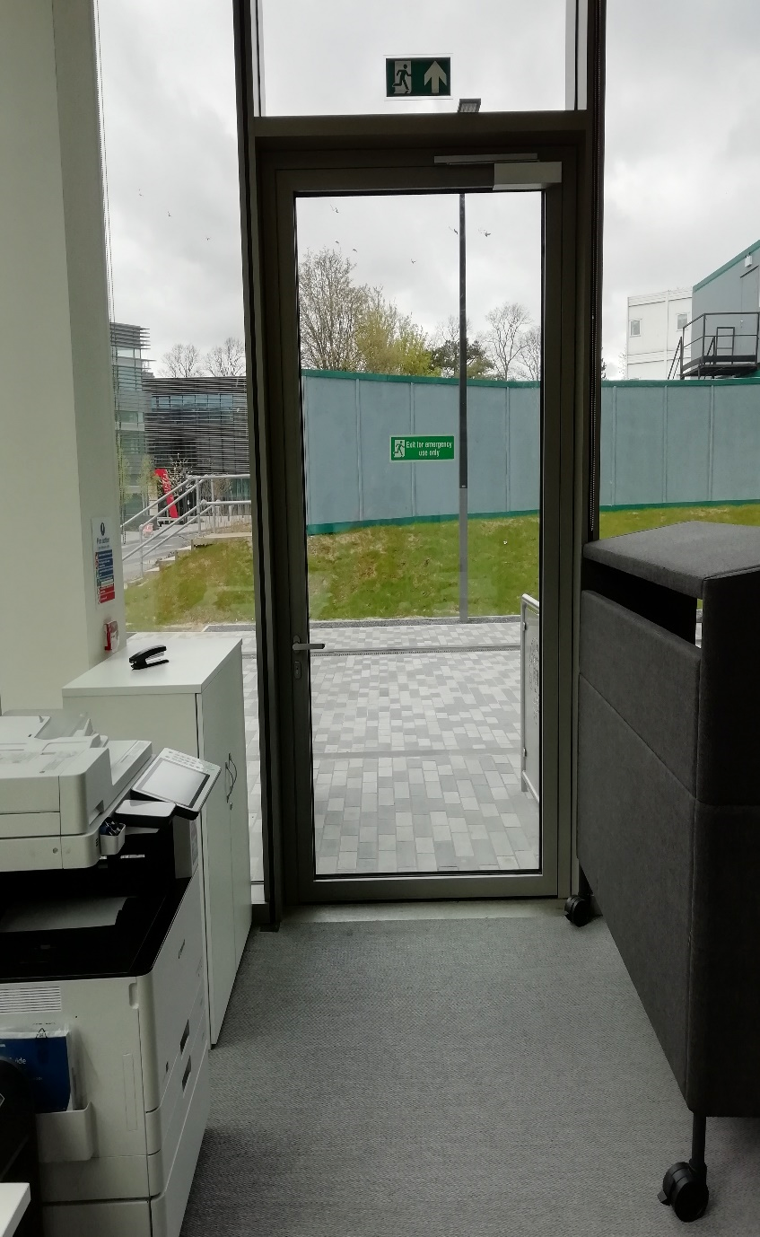
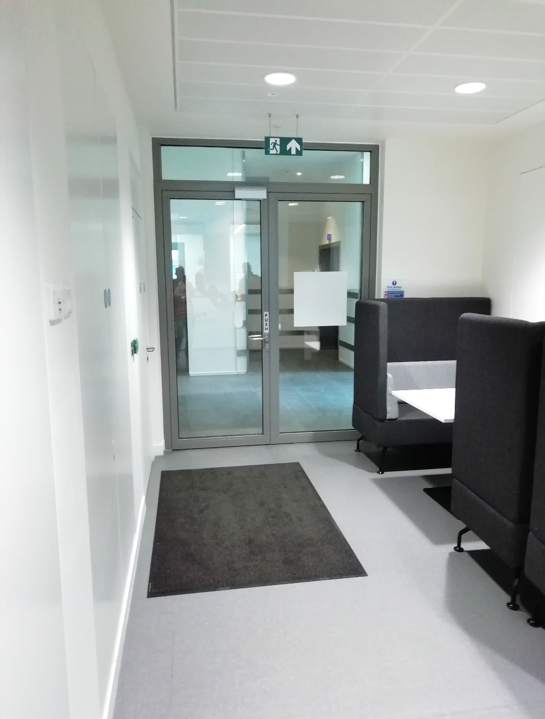
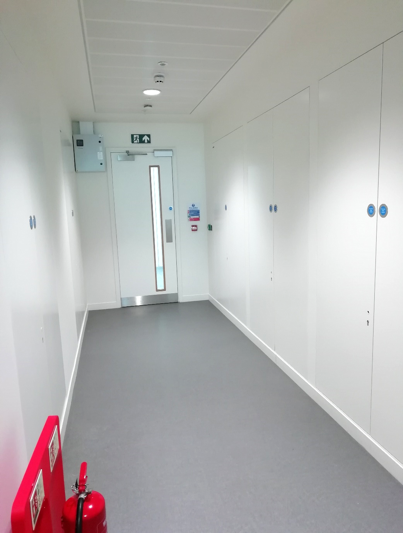
Fire Exits
The Hub
First floor
First floor

Slide 6
Emergency door release
Located on wall on every fire exit door
If you need to use the Emergency Door Release button, please inform Security Services on
01865 272944 once you are safely away from the exit

Slide 7
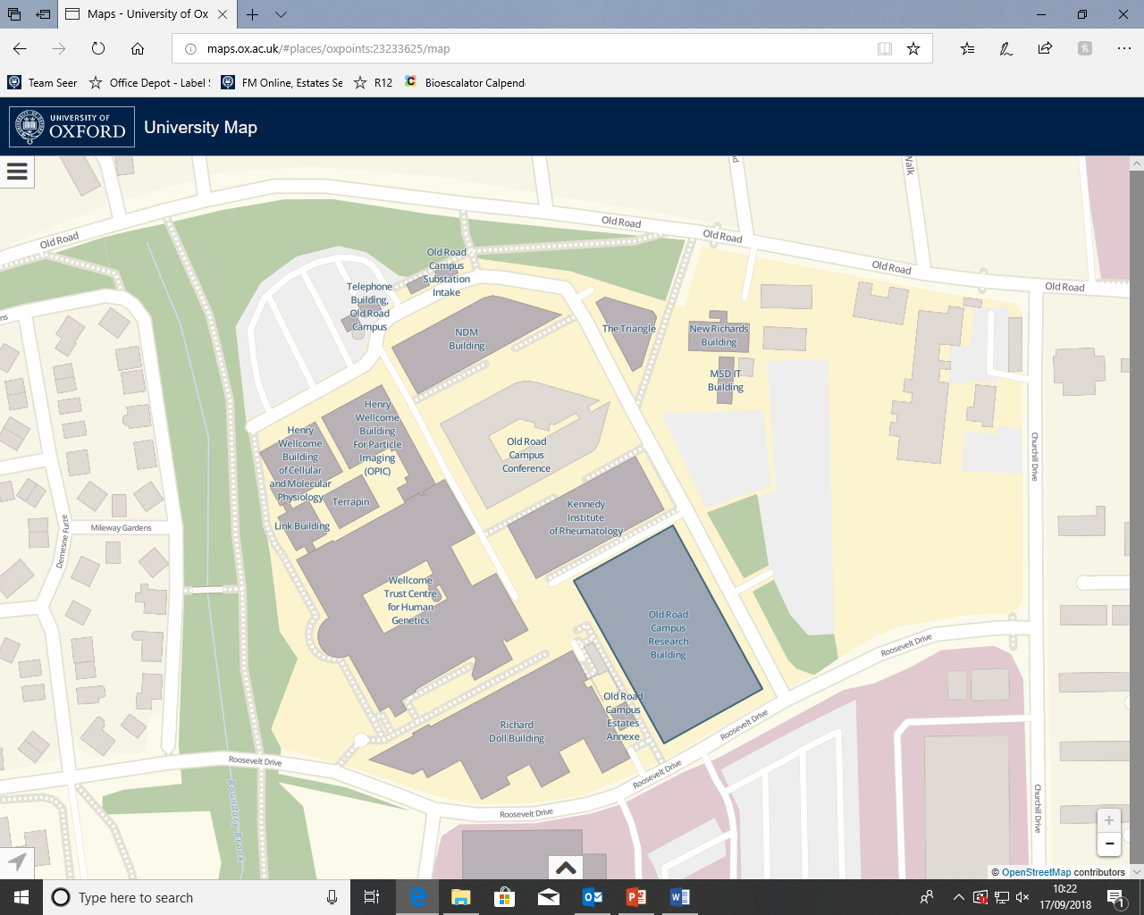
Fire assembly point
Assembly
Point
Innovation Building
Car park & Distribution centre

Slide 8
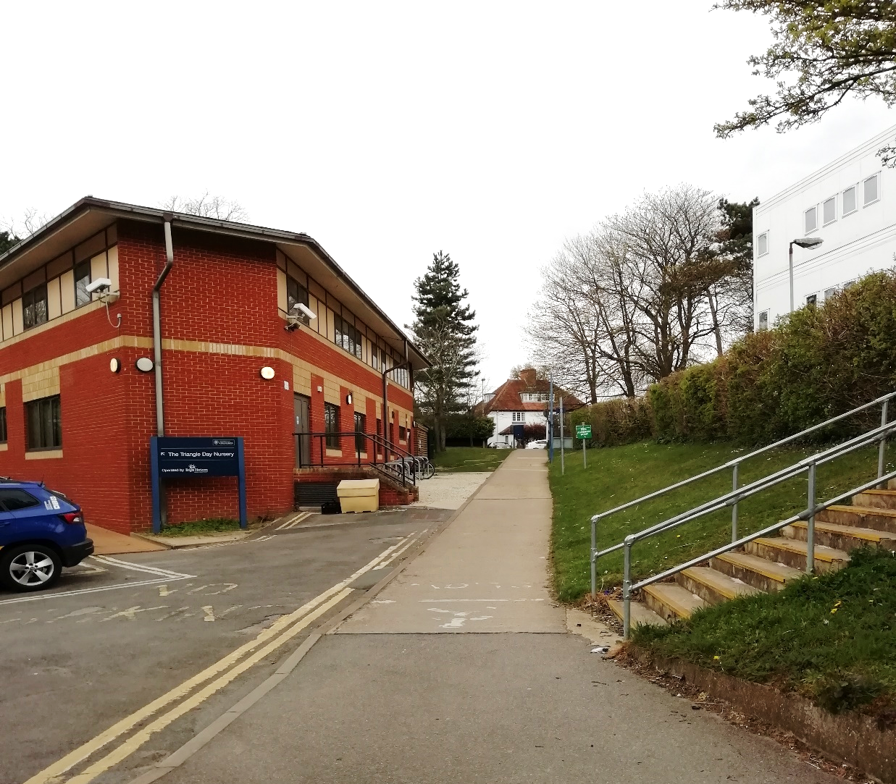
Fire assembly point
The Triangle Nursery
Fire assembly point
adjacent to triangle
nursery
Assembly
Point

Slide 9
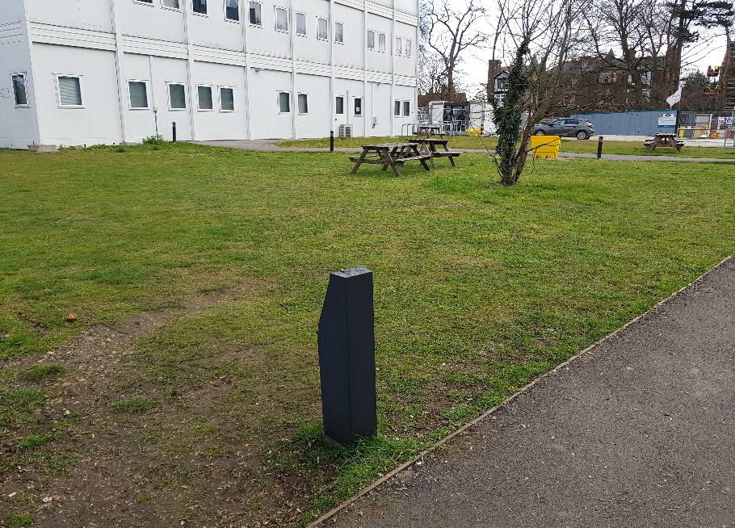
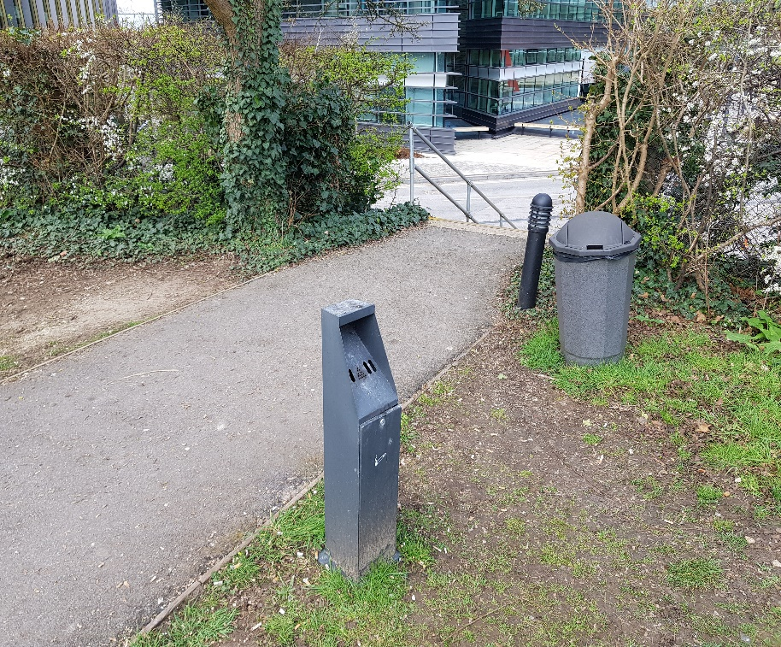
No smoking on ORC
New Richards Building
Designated smoking area- which is the raised grass area adjacent to the triangle nursery
The Triangle Nursery
Steps to the designated smoking area

Slide 10
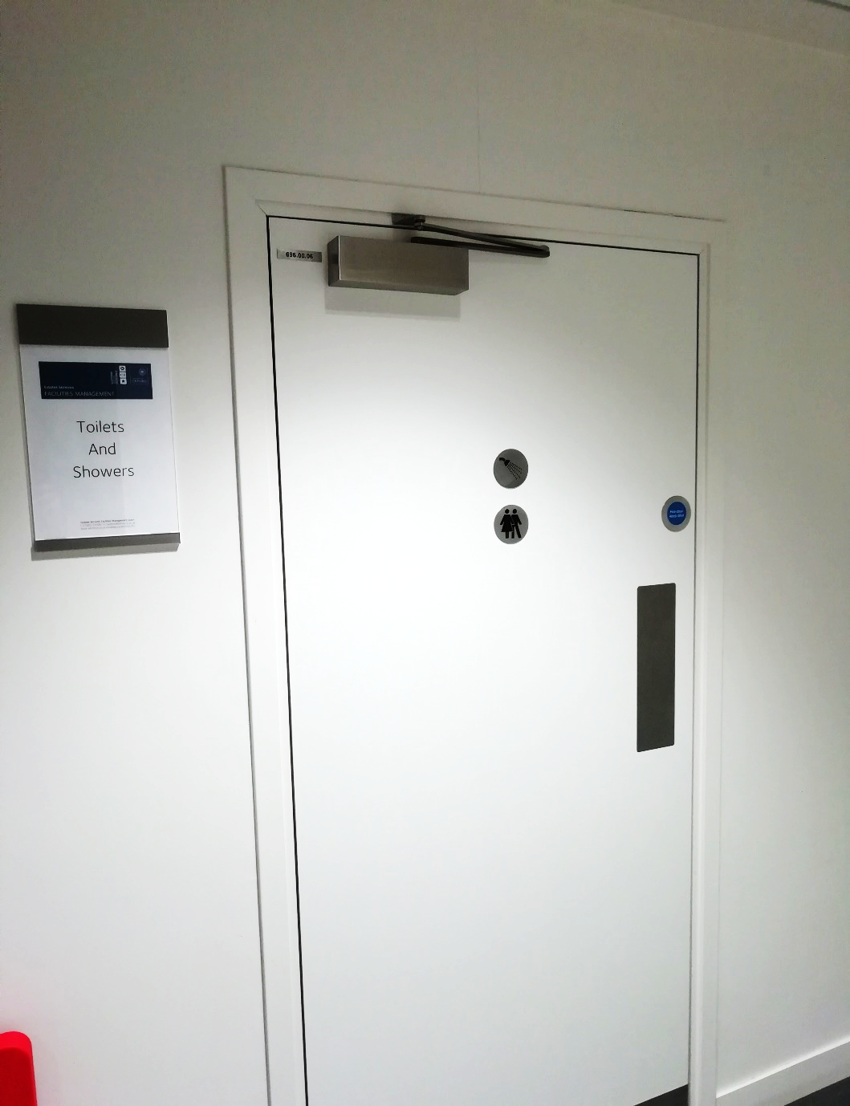
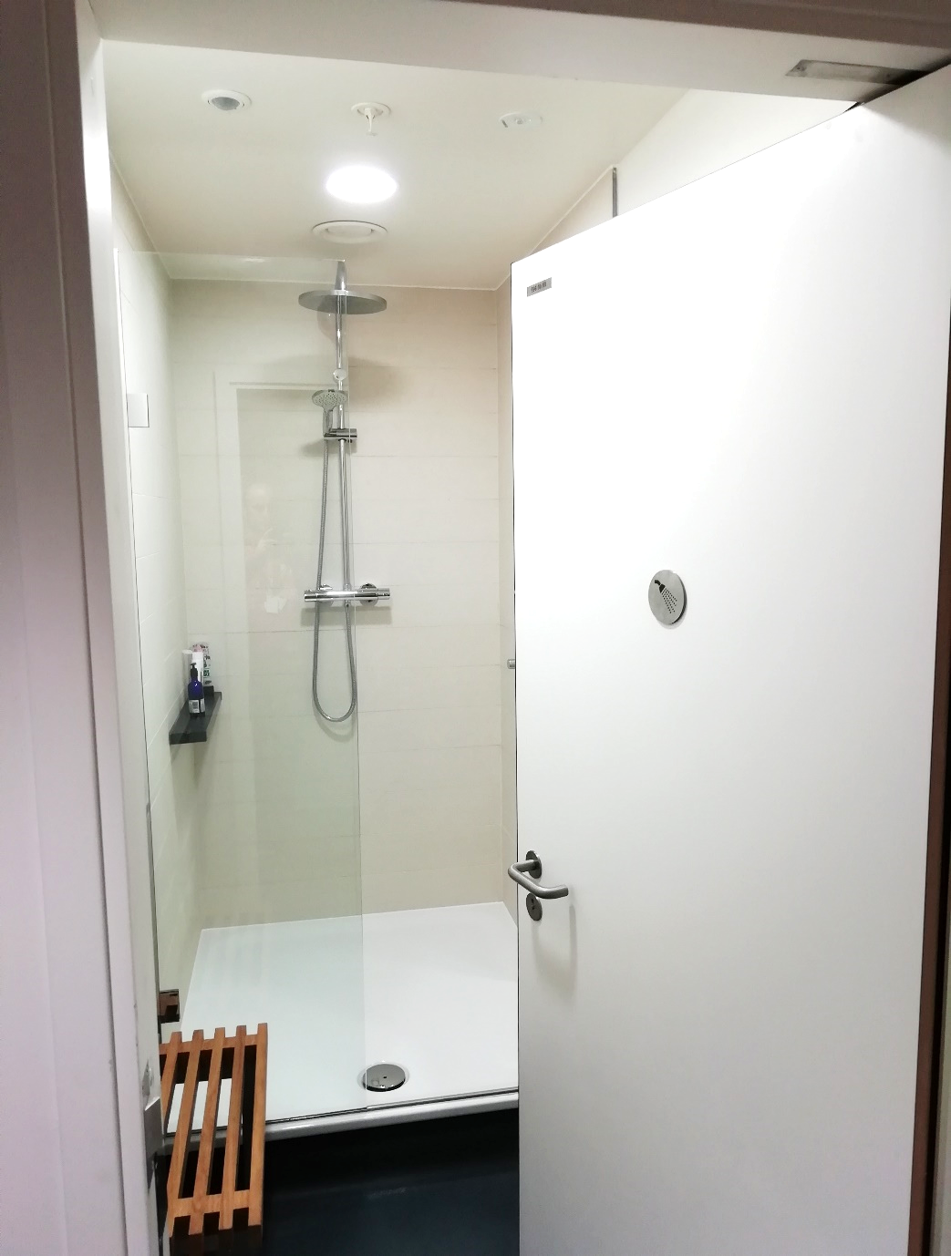
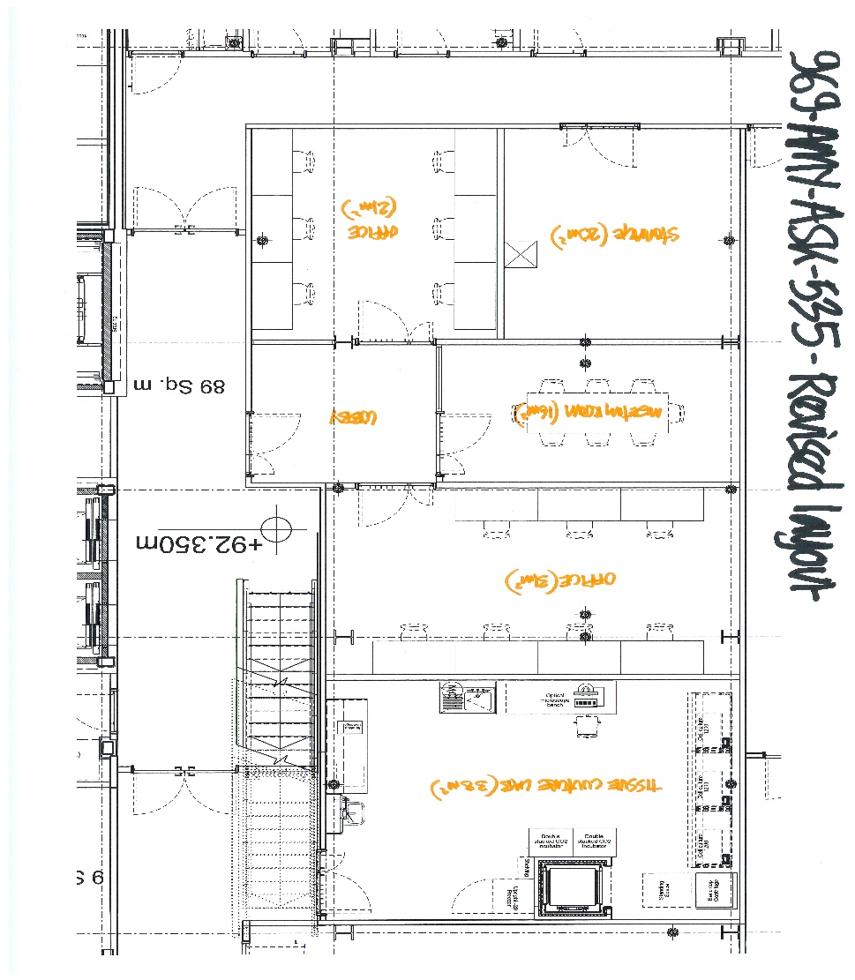
Shower facilities in Basement
Shower
Facilities

Slide 11
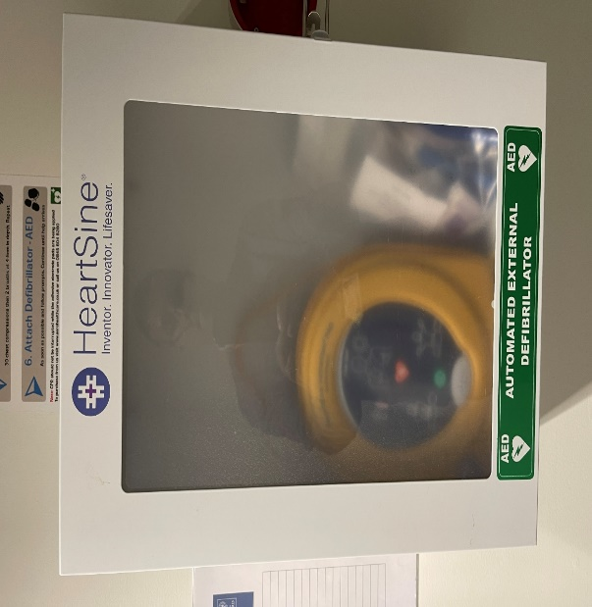
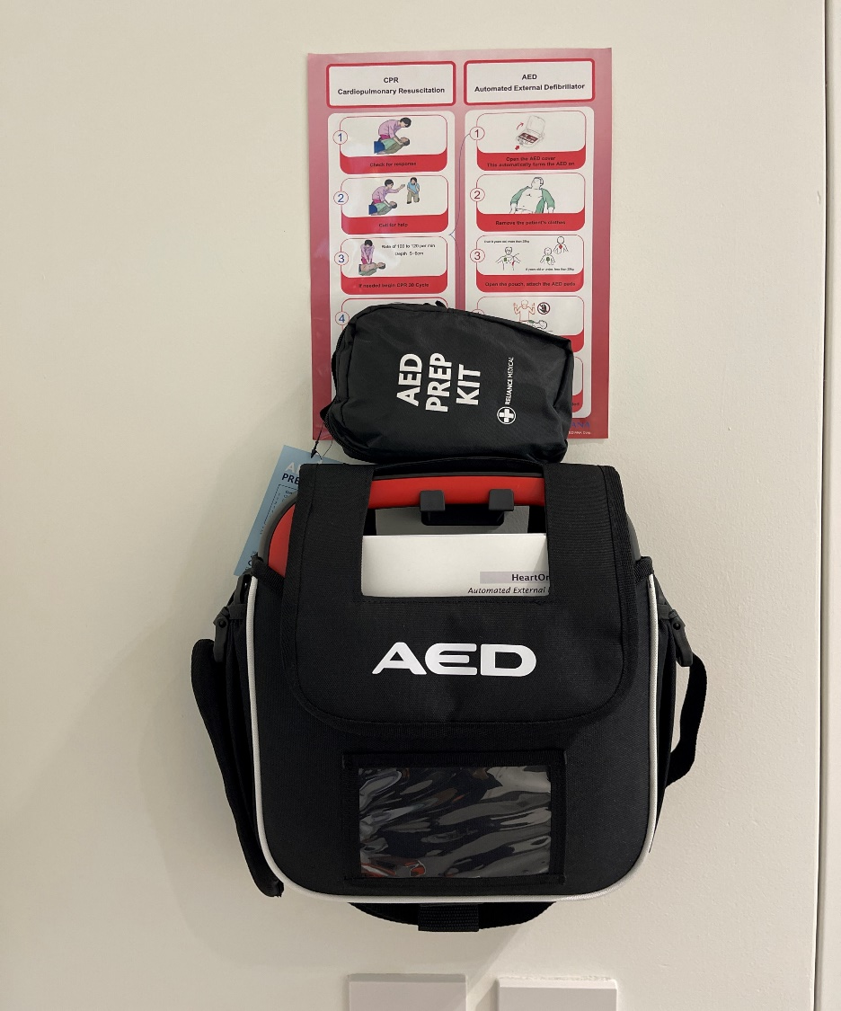
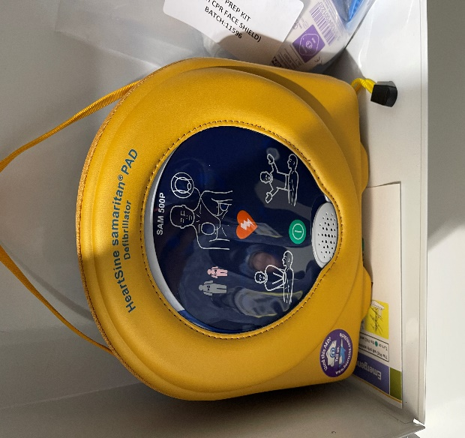
Defibrillator in Basement & Reception
Located in the basement outside OUSS office.
Located on the ground floor at Reception
Fire Exit
Passenger Lift
Goods Lift
AED
OUSS office

Slide 12
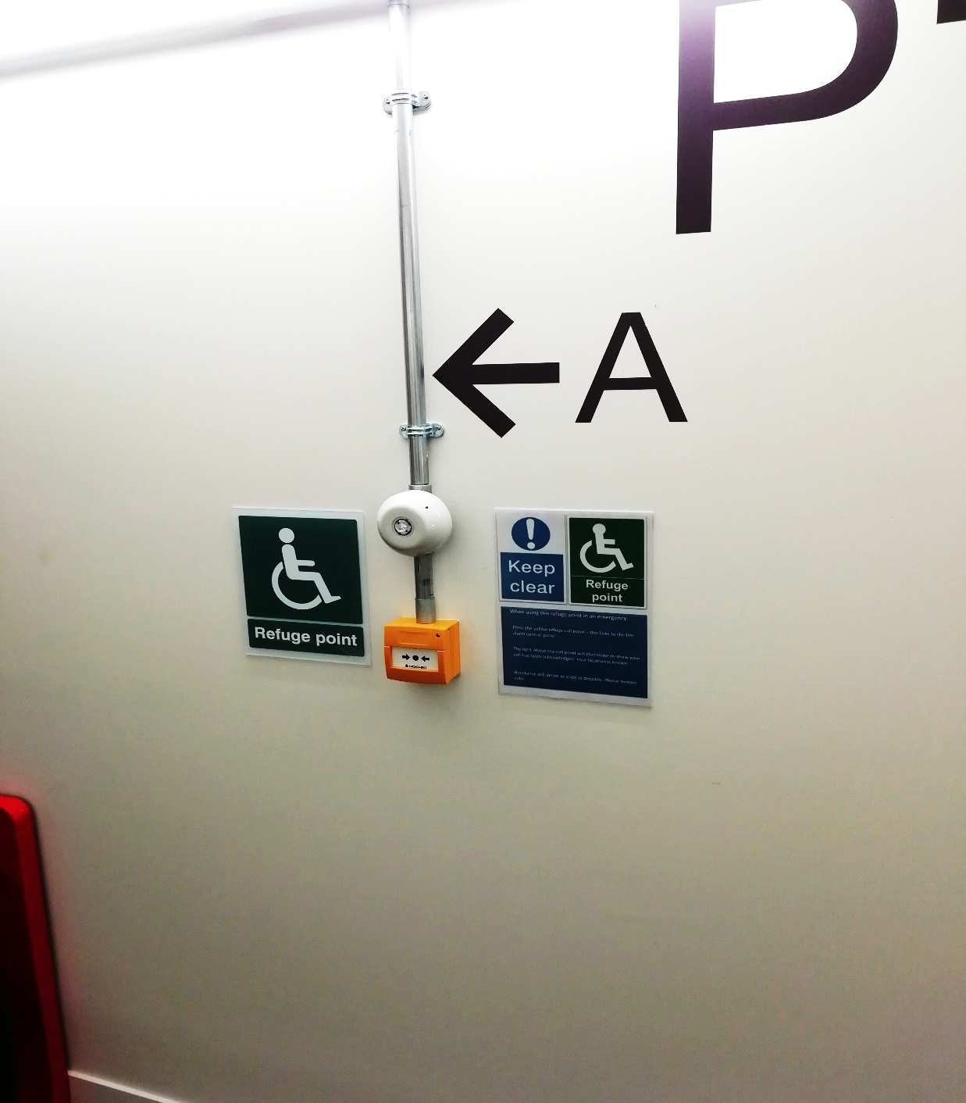
Refuge points
Located on first, second, and third floor stairwell
Evac chair is located on every floor of the car park except ground floor
Ibex chair is only located in the basement
Notes:
Evac chair enables one person to evacuate a physically impaired person safely and easily down the stairs in the event of an emergency or when lifts cannot be used. Also has carry handles for two people to carry one person upstairs & over obstructions.
Ibex is an emergency evacuation chair for safely evacuating non-ambulant individuals up and down stairs without carrying or heavy lifting.

Slide 13
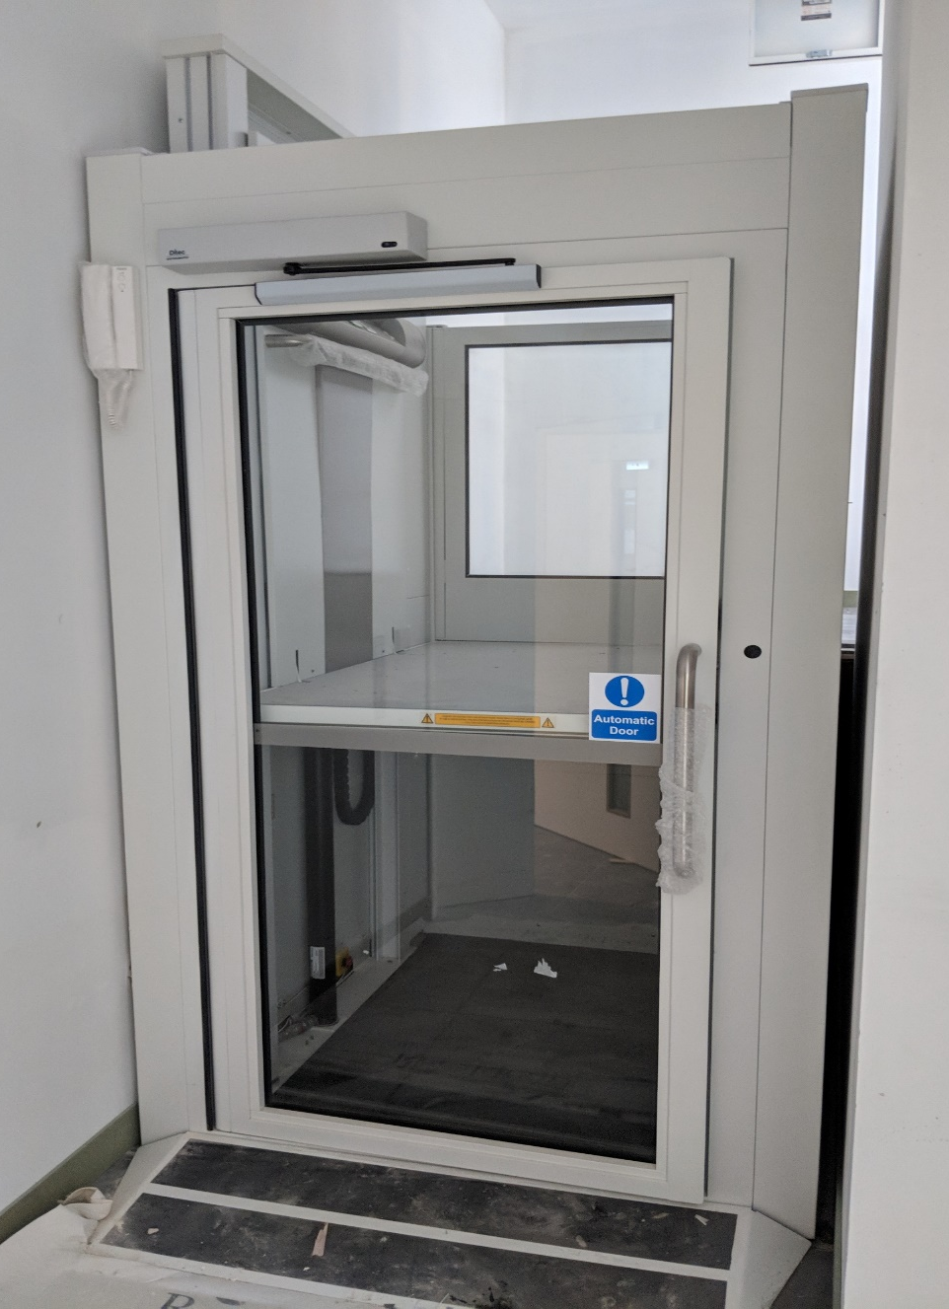
Accessible platform
Located at the back of the Innovation building
leading into the BioEscalator garden and bike shed

Slide 14
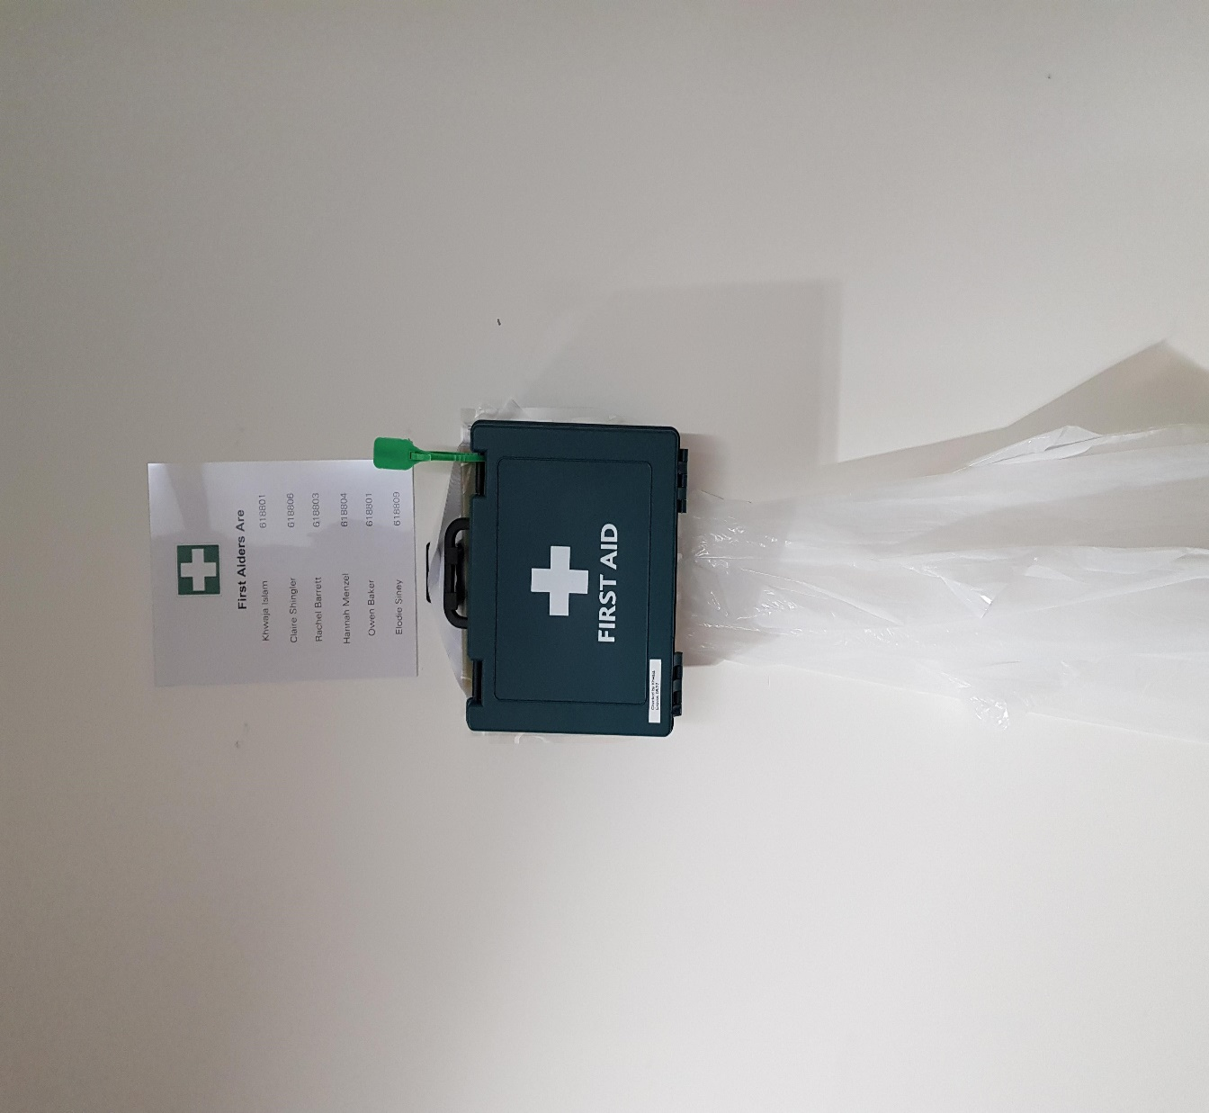
First Aid station & Accidents
Located on the basement, ground
and first floor
Accident/incident are reported
on-line (IRIS) now
Eye wash stations in all the labs

Slide 15
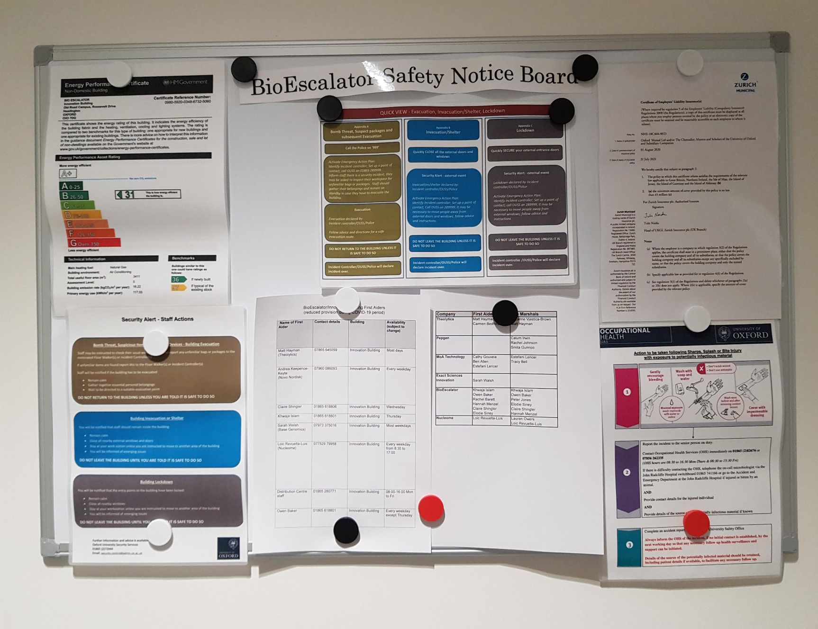
Safety notice board
Located on the ground floor next to
ground floor toilets.

Slide 16
Any Questions?

